Slide 1
Windows Device driver chatbot
-Ajith prabhakaran

Slide 2
Purpose
AI assistant for Windows Device Driver Development, running fully offline on Windows. This will answer questions related to WDD architecture, API’s & debugging tools. This can also demonstrate sample driver code generation if needed.

Slide 3

technology overview

Slide 4
architecture
Frontend : Python desktop UI (Tkinter)
Backend : Python service layer (RAG pipeline)
Inference Engine : llama.cpp (CPU-based, no GPU dependency)
Model : Phi-3 Mini (4K context, quantized GGUF)

Slide 5
AI pipeline
User Query
Intent Classification
Small talk / driver-related / code generation
3. Document Retrieval
FAISS vector index (local embeddings)
4. Prompt Construction
Explanation or Code-focused prompts
5. Local LLM Inference
Executed via llama-cli.exe
6. Response Rendering
Natural language or code output

Slide 6
Key technologies
LLM : Phi-3 Mini (Microsoft)
Vector Store : FAISS
Embeddings : Hugging Face (local)
LLM Orchestration : LlamaIndex
Packaging : PyInstaller (offline Windows EXE)

Slide 7
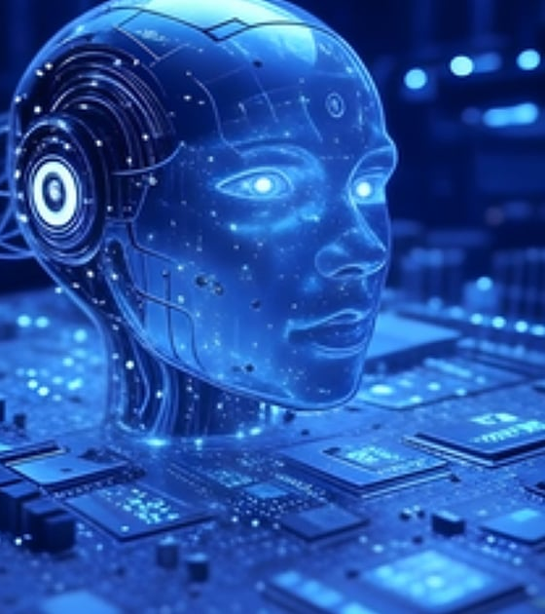
Tool benefits
Why this matters

Slide 8
Security & deployment
✅ 100% Offline (no cloud calls)
✅ No source code exposure
✅ No data leaves machine
✅ Portable EXE distribution

Slide 9
Why this?
Works in restricted corporate environments
No internet / API keys / GPUs required
Fast, deterministic, reproducible responses
Tailored specifically for Windows driver engineers

Slide 10

Thank you
AJITH PRABHAKARAN

